Slide 1

HOSPITAL MANAGEMENT SYSTEM -GROUP 3

Slide 2

Group-3
G S Sruthi -2527967
GopalaKrishnan Jayapandi -2526861
Haritha B -2528708
HarshVardhan -2528209
Hemsri Mannarsamy -2528668
Hridoy Sutar -2525625
Indukuri Durga Sindhu -2527753
KamalaKannan Kathavarayan -2529138
Kamali S -2529186
Kanimozhi Mahendran -2528622

Slide 3
Contents
Introduction
Why Hospital Management System?
Objectives
App Flow
System Requirements
Tools & Languages Used
Features Available
Future Scope &
Improvement
Conclusion

Slide 4
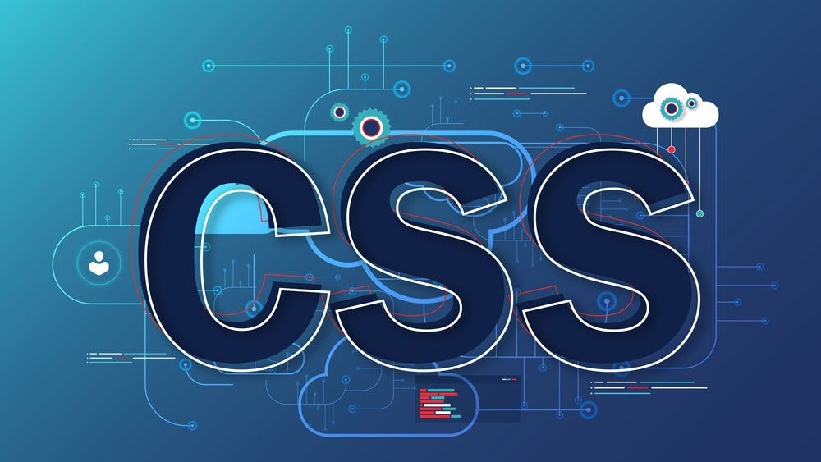


Tools And Languages
Front End
Angular
Html
CSS
Angular material
BOOTSTRAP
Back End
MySQL
Spring Boot
Hibernate
Postman (Testing)

Slide 5

System Requirements
The Basic System Requirements for Running this project are listed below:
Visual studio, Eclipse, Postman and MySQL are to be installed to the system
1 GB Random Access Memory
200 MB of Free Space on Hard Disk
Microsoft Windows 8,10,11 or Linux or Equivalent OS
Web Browser (Microsoft Edge, Google Chrome, Firefox)

Slide 6

Introduction

Slide 7

Introduction
The purpose of the project entitled as “HOSPITAL MANAGEMENT SYSTEM” is to computerize the Front Office Management of Hospital to develop software which is user friendly, simple, fast, and cost – effective. It deals with the collection of patient’s information, diagnosis details, etc.
It is accessible by an administrator. The data can be retrieved easily. The interface is very user-friendly.
Hospital Management System is a system enabling hospitals to manage information and data related to all aspects of healthcare

Slide 8

Objective
To computerize all the details regarding patient and doctor
Scheduling the appointment of patient with doctors to make it convenient for both
Hospital Management System enables you to develop your organization and improve its effectiveness and quality of work
Design a system for better patient care
Reduce hospital operating costs

Slide 9

Why Hospital Management System?
The HMS is a website that takes care of the complete hospital functionalities
The integrated system can be customized and are developed
Optimum Management of all hospital doors
Developed to control all hospital operations like:
Database management
Booking appointment
Billing
Administration
Patient medical history

Slide 10
Modules Of Hospital Management System
PATIENT MODULE
DOCTOR MODULE
ADMIN MODULE
APPOINTMENT MODULE
DISCHARGE MODULE
FEEDBACK MODULE

Slide 11




Features Available
Header
About Us
Testimonials
Gallery
Contact
Navigation bar
Sign-up and Login
Create Admin Account
Doctor and Patient List
Appointment
Invoice
Sign-up and Login
Book an appointment
Invoice
Feedback
Sign-up and Login
Create Doctor Account
Patient List
Appointment
Patient Discharge

Slide 12
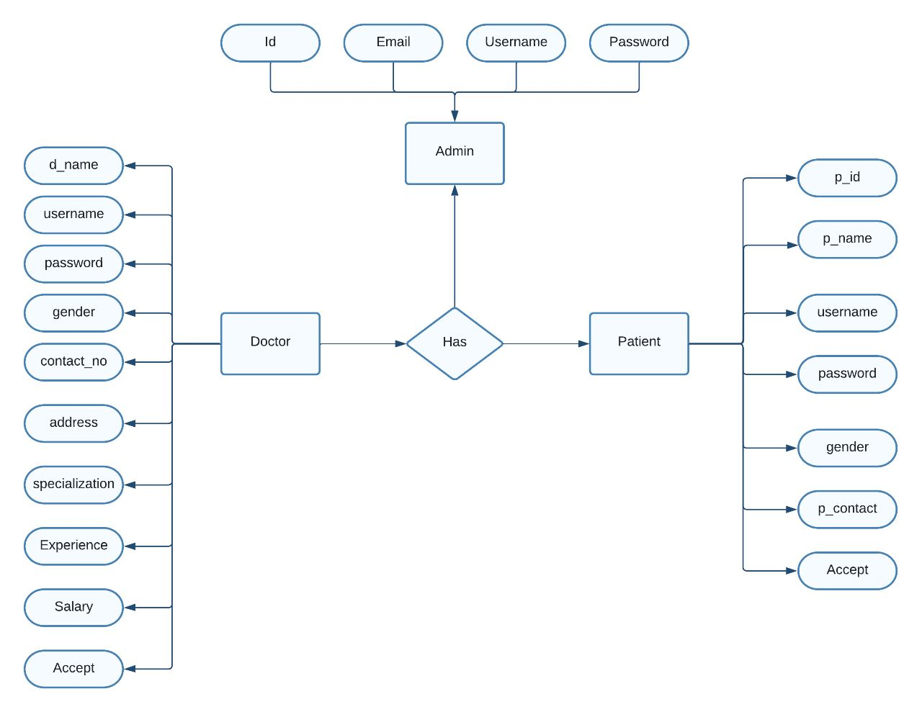
App Flow

Slide 13

Home Page

Slide 14
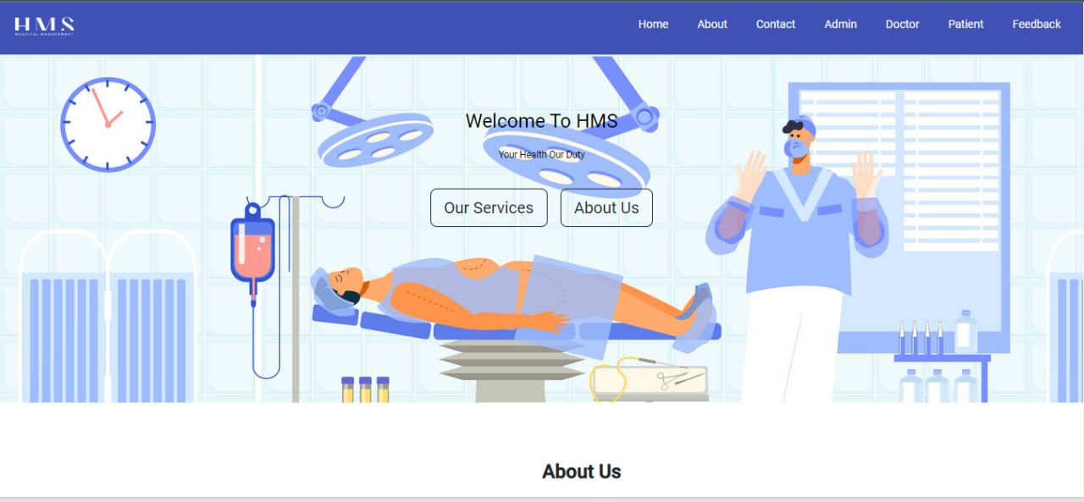
Home Page

Slide 15
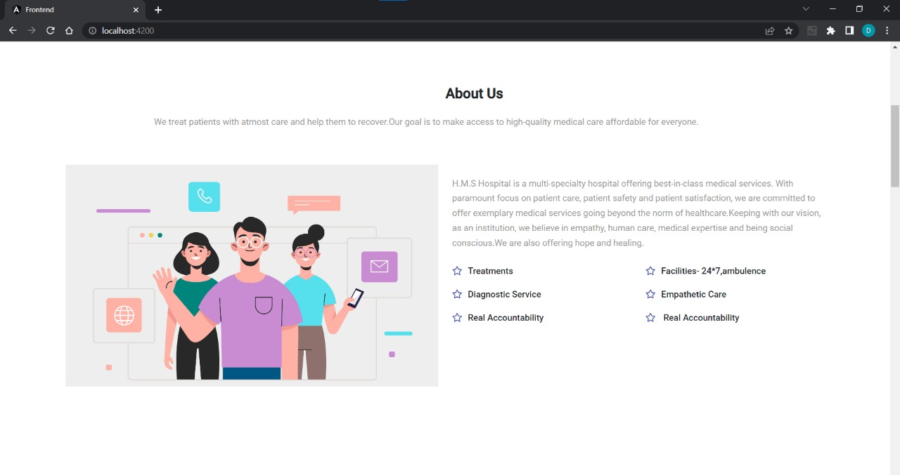
About Us

Slide 16
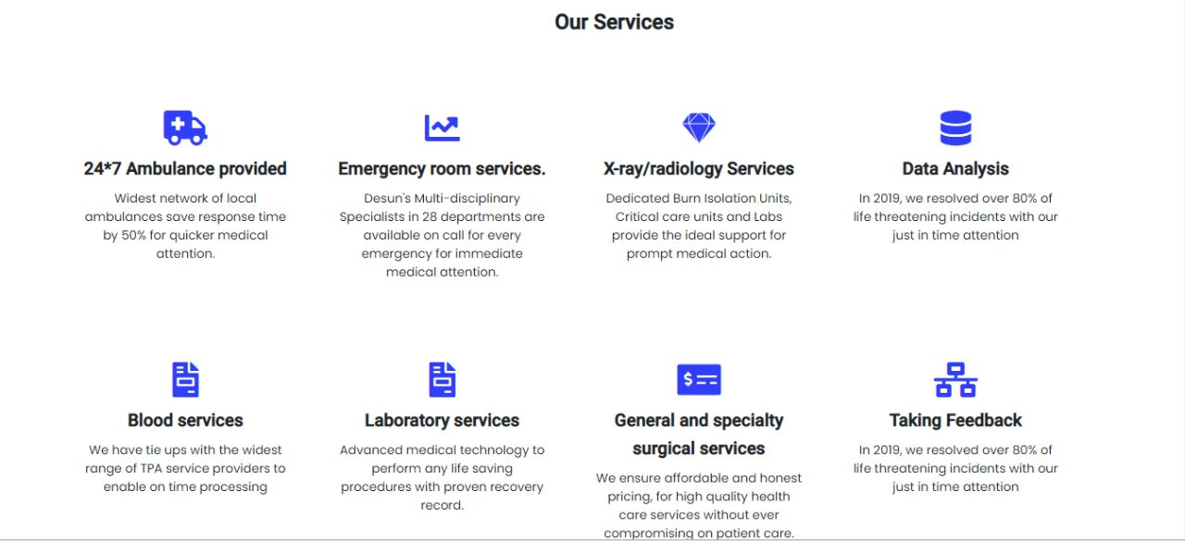
Our Services

Slide 17
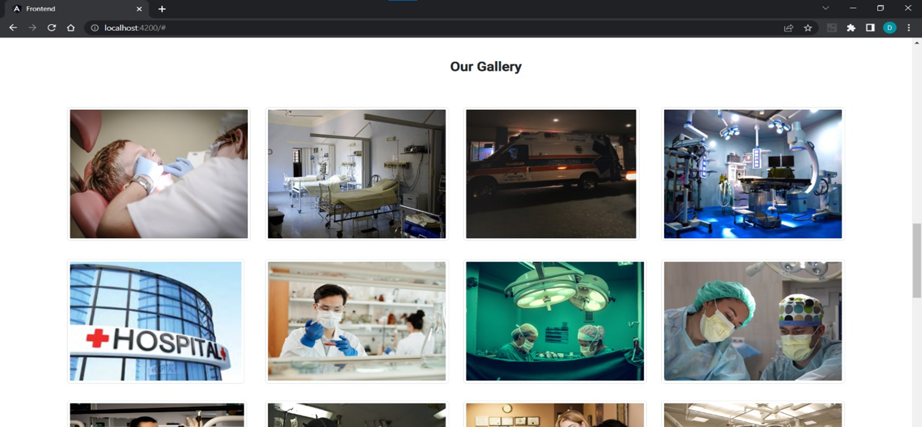
Our Gallery

Slide 18
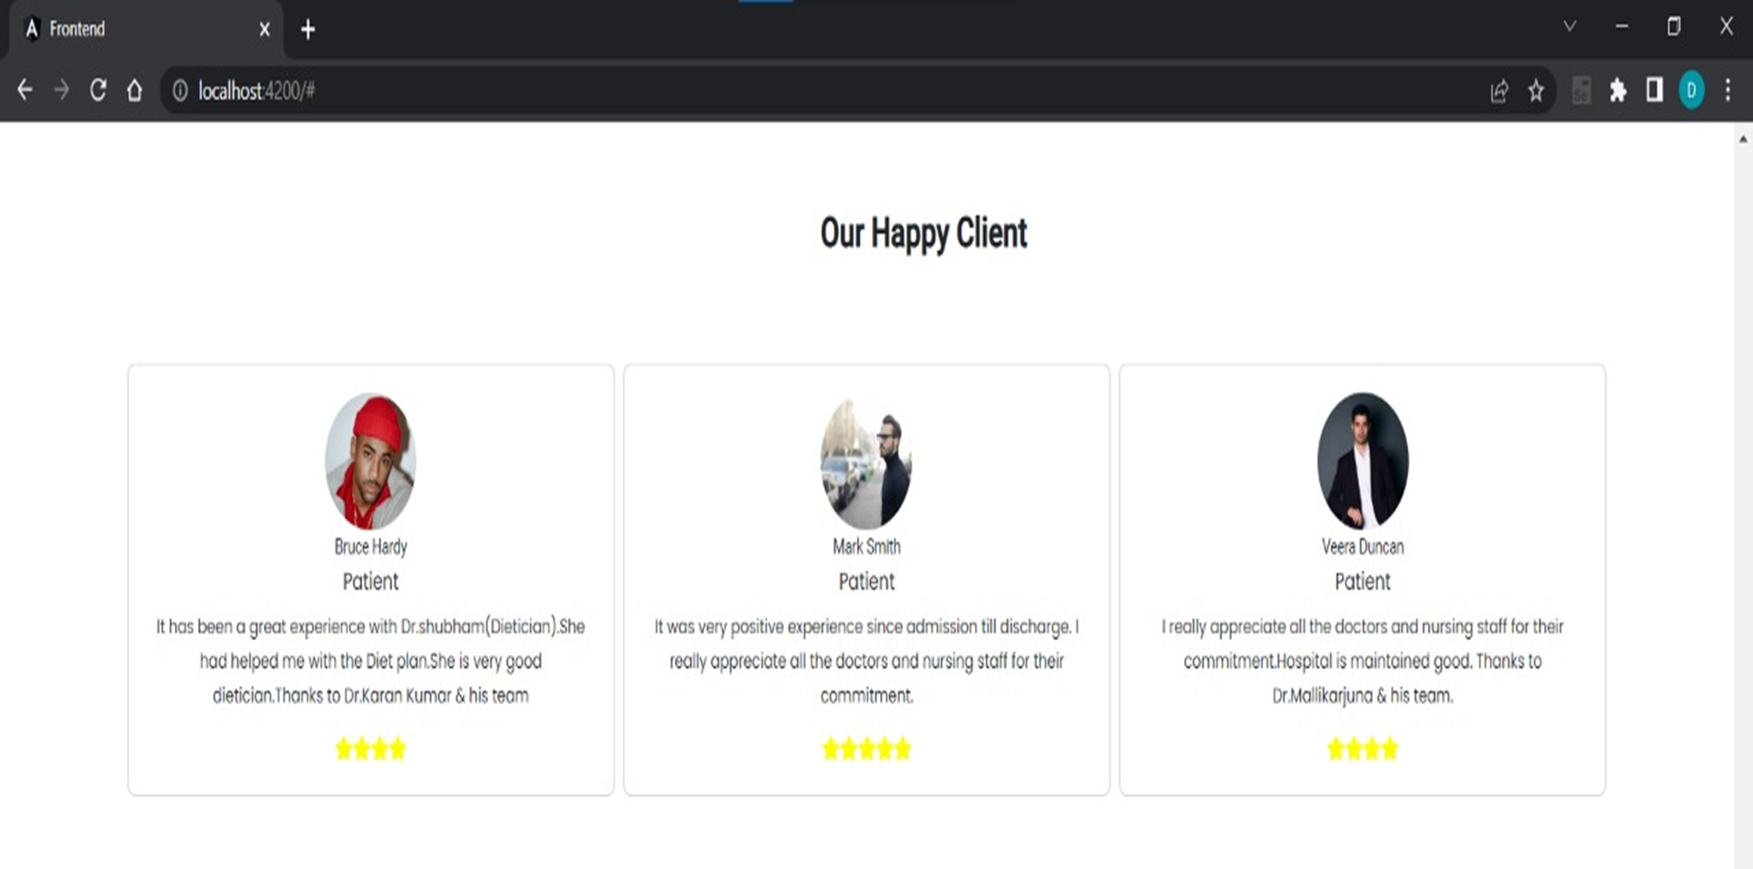
Our Happy Client

Slide 19
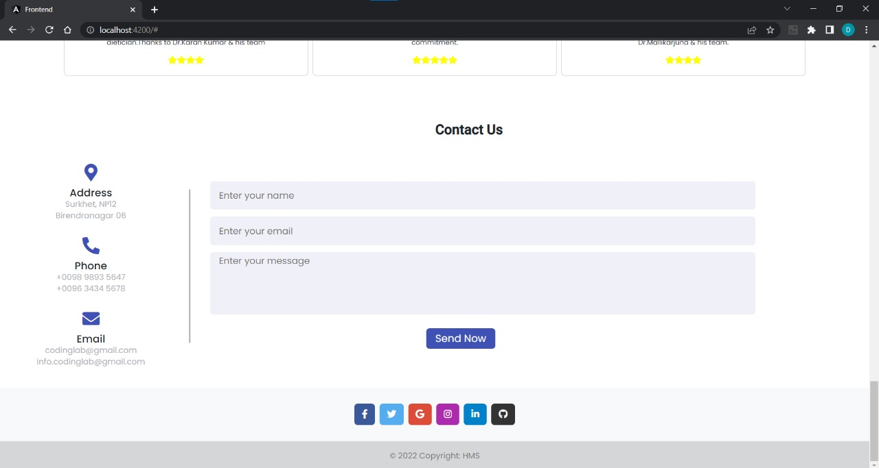
Contact Us

Slide 20

Admin Module

Slide 21

Admin Module
In the Admin Module the Admin could sign-up and Login
The Admin can see the Doctor List, Patient List and Feedbacks
In the Doctor’s List, the Admin can perform CRUD operations like UPDATE and DELETE
In the Patient’s List the Admin can perform CRUD operations like UPDATE and DELETE

Slide 22
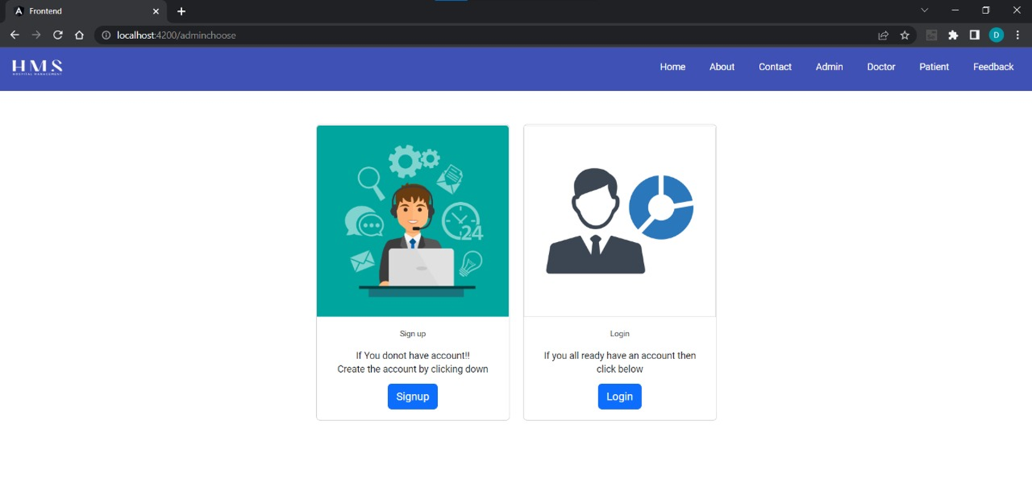
Admin

Slide 23
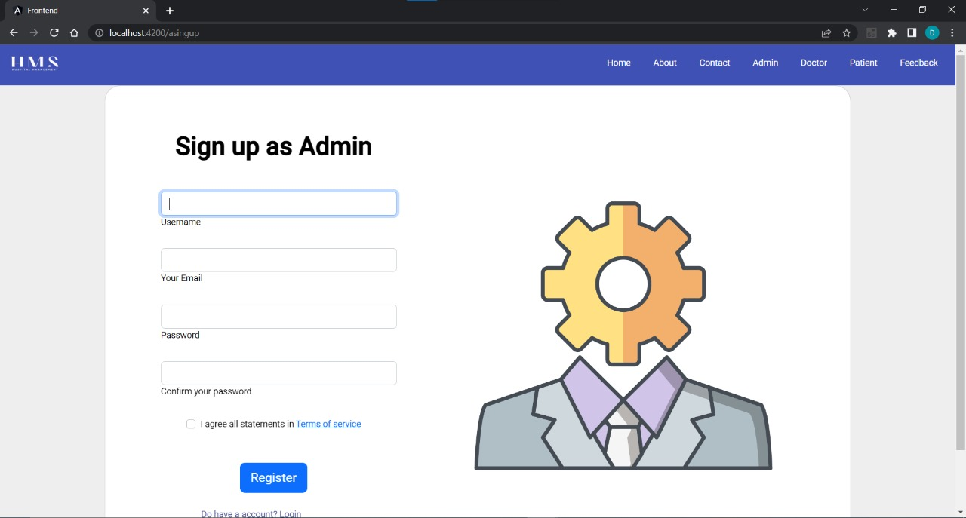
Admin Signup

Slide 24
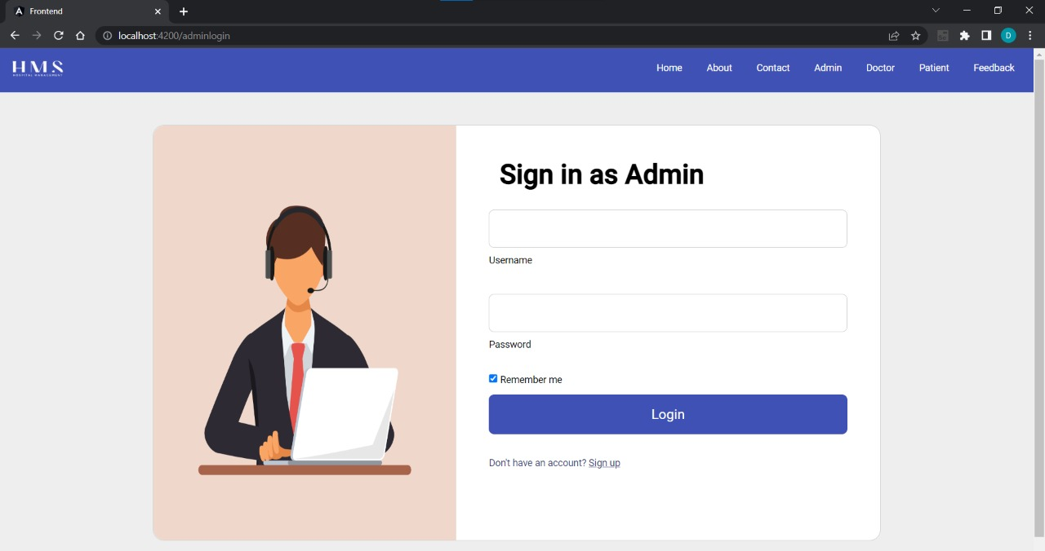
Admin Login

Slide 25
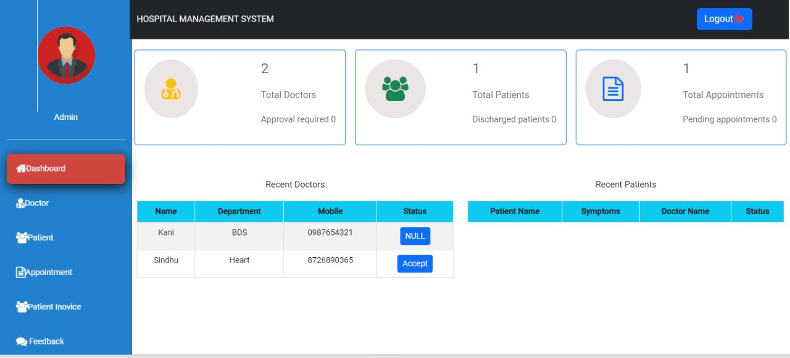
Admin Dashboard

Slide 26

Doctor Module

Slide 27


Doctor Module
Doctor can Sign-up and Login
Doctor can see the Appointment and Discharge List
Doctor can DELETE the Appointments once attended

Slide 28
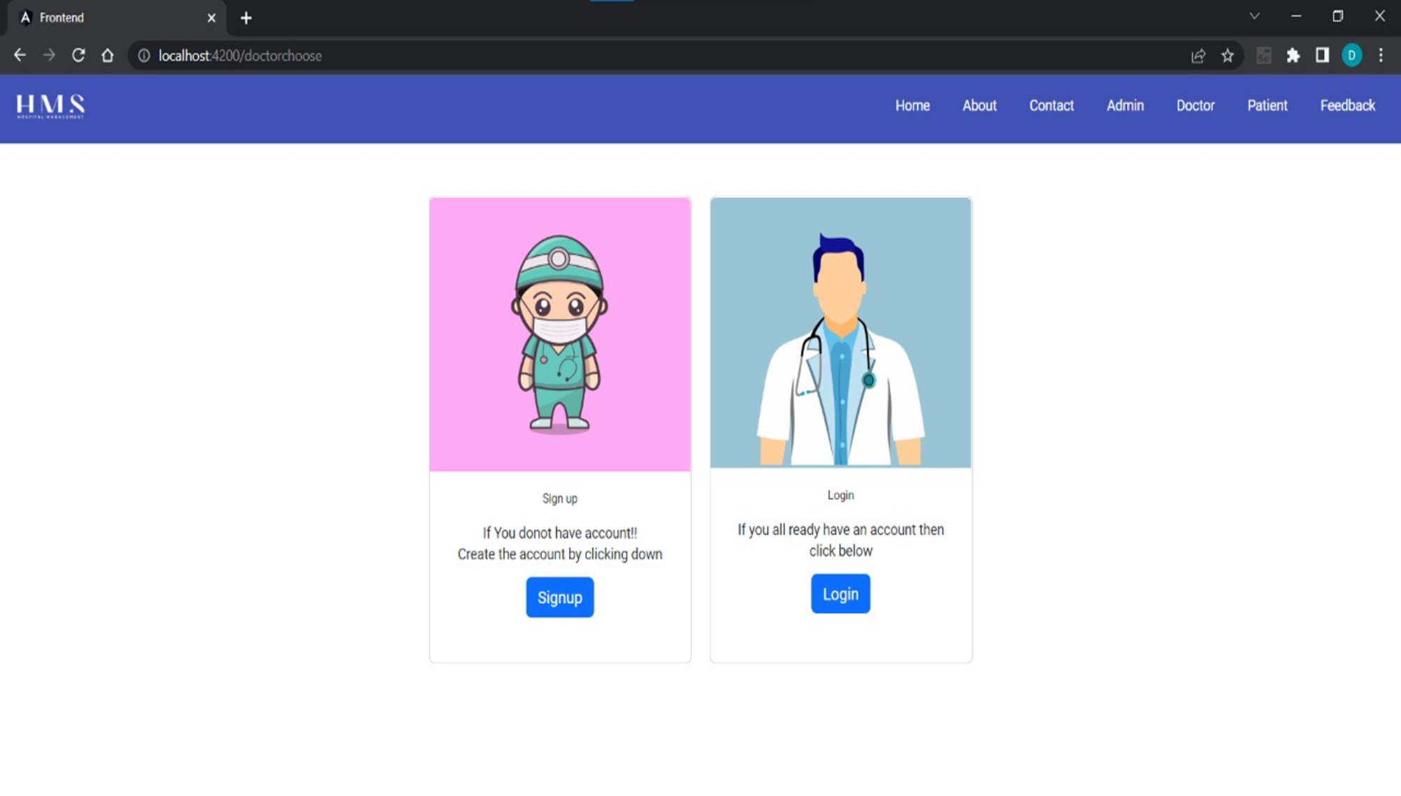
Doctor

Slide 29
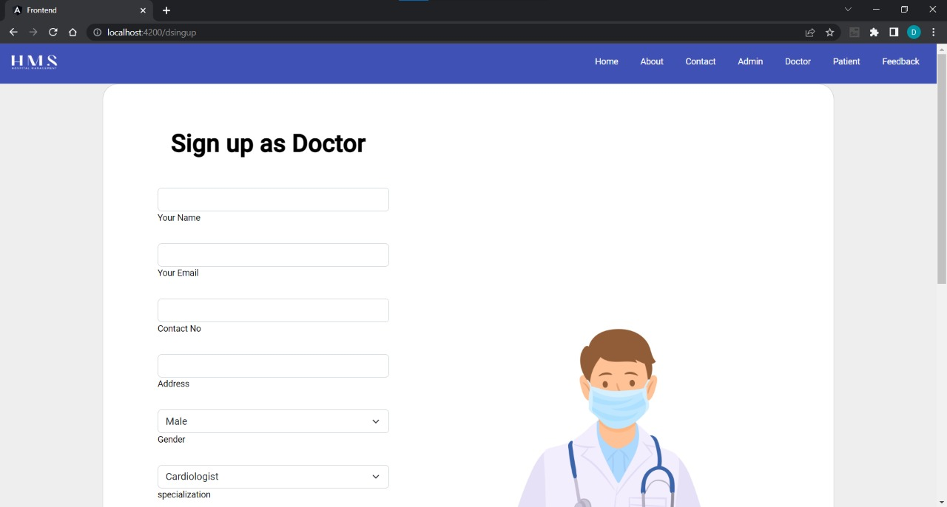
Doctor Signup Page

Slide 30
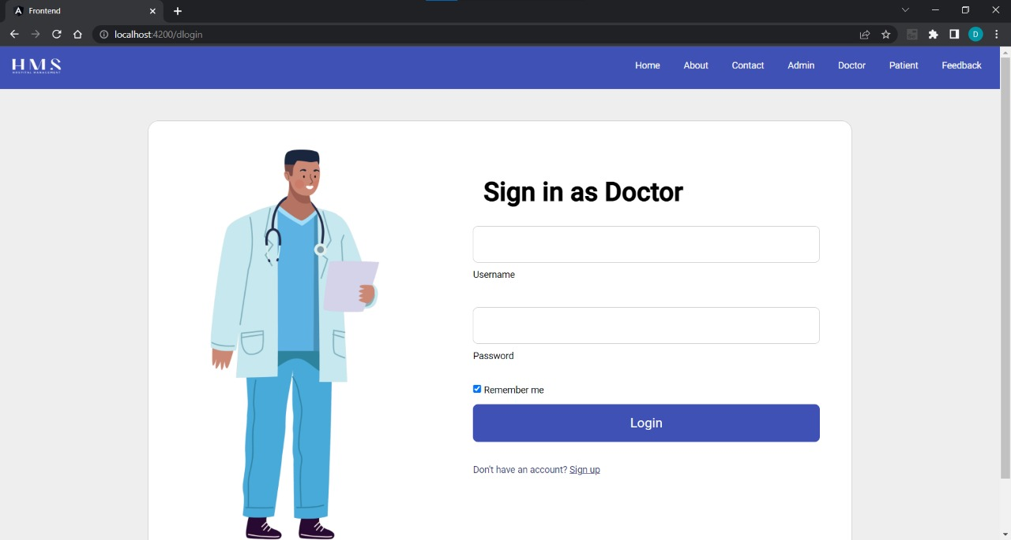
Doctor Login Page

Slide 31
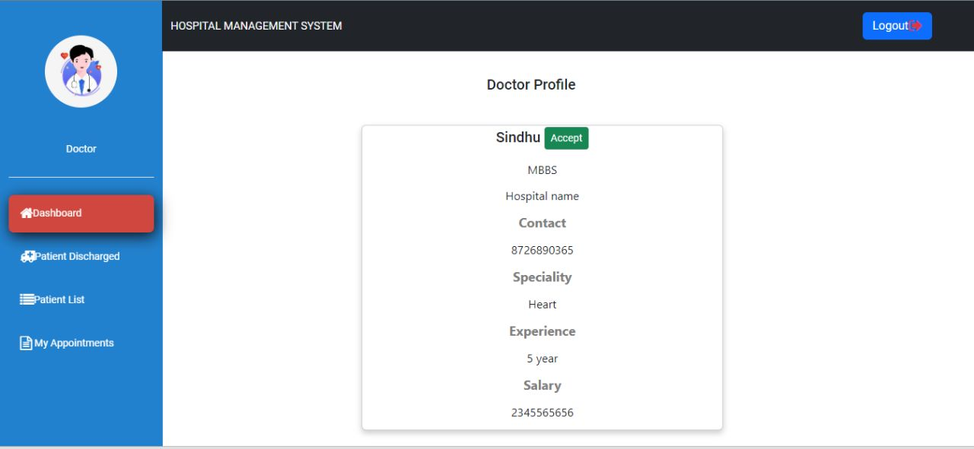
Doctor Dashboard Page

Slide 32

Patient Module

Slide 33
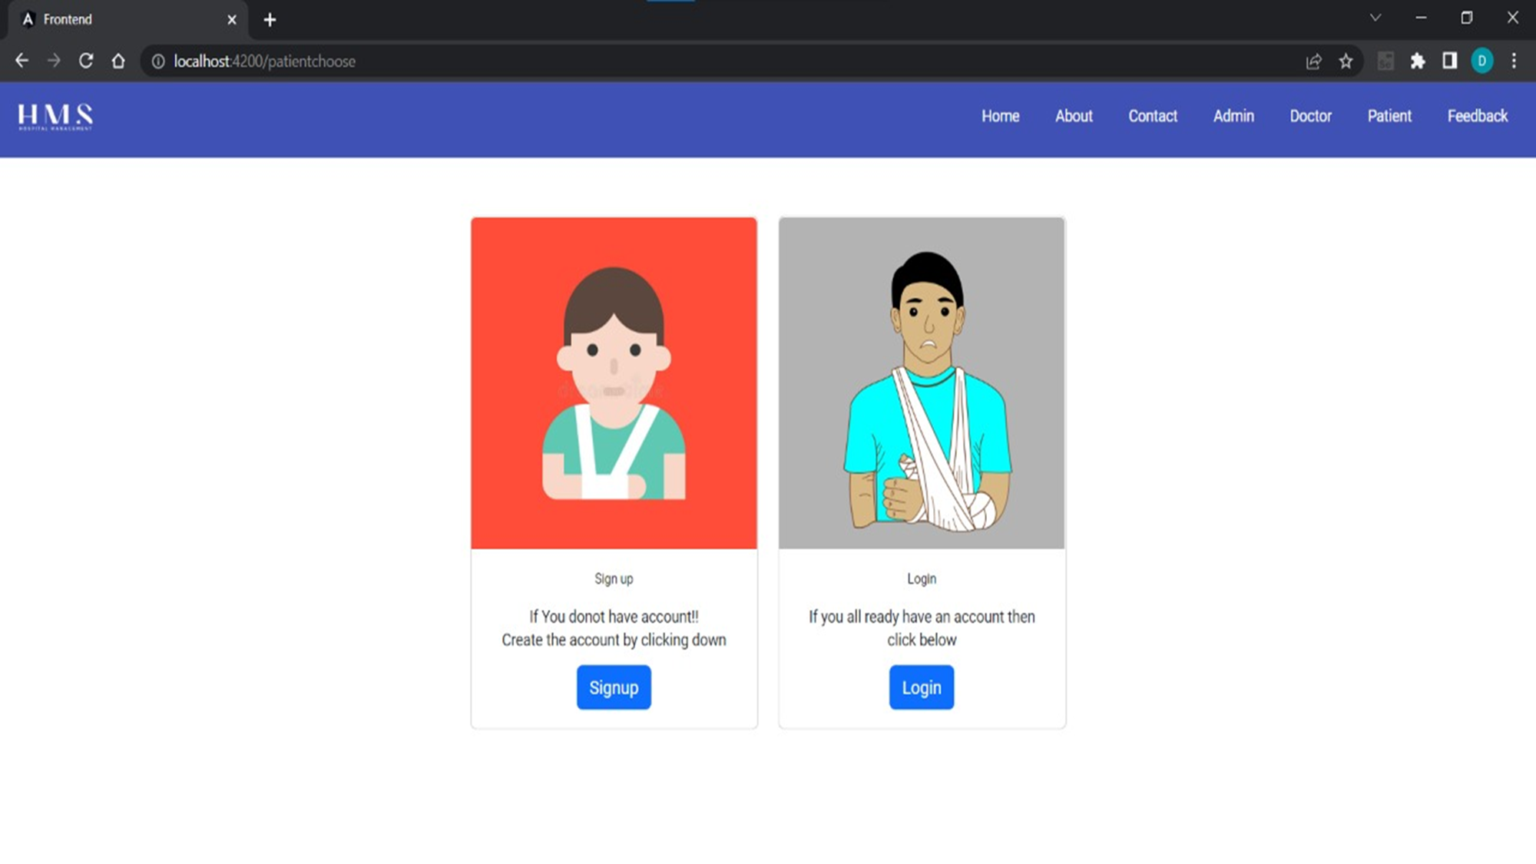
Patient

Slide 34


Patient Module
Patient can Sign-up and Login
Patient can register the Appointment
Patient can see the Doctor who is allotted by the admin
Patient can give the Feedback about the service provided by the hospital

Slide 35
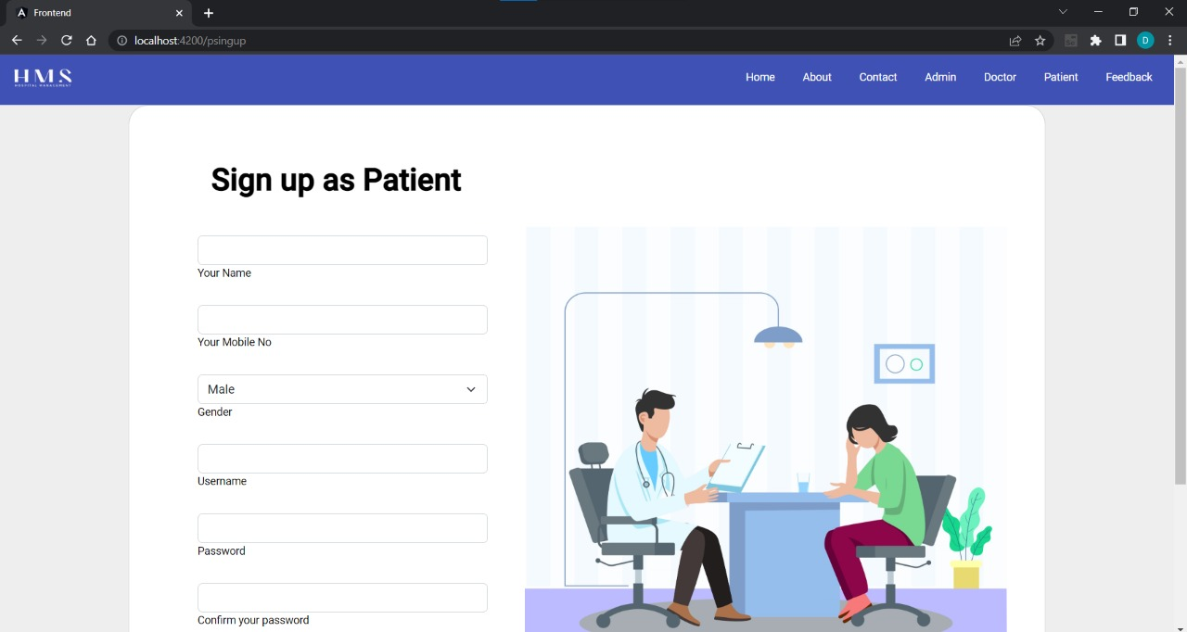
Patient Signup Page

Slide 36
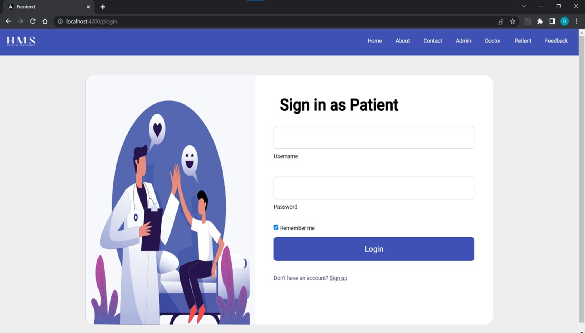
Patient Login Page

Slide 37
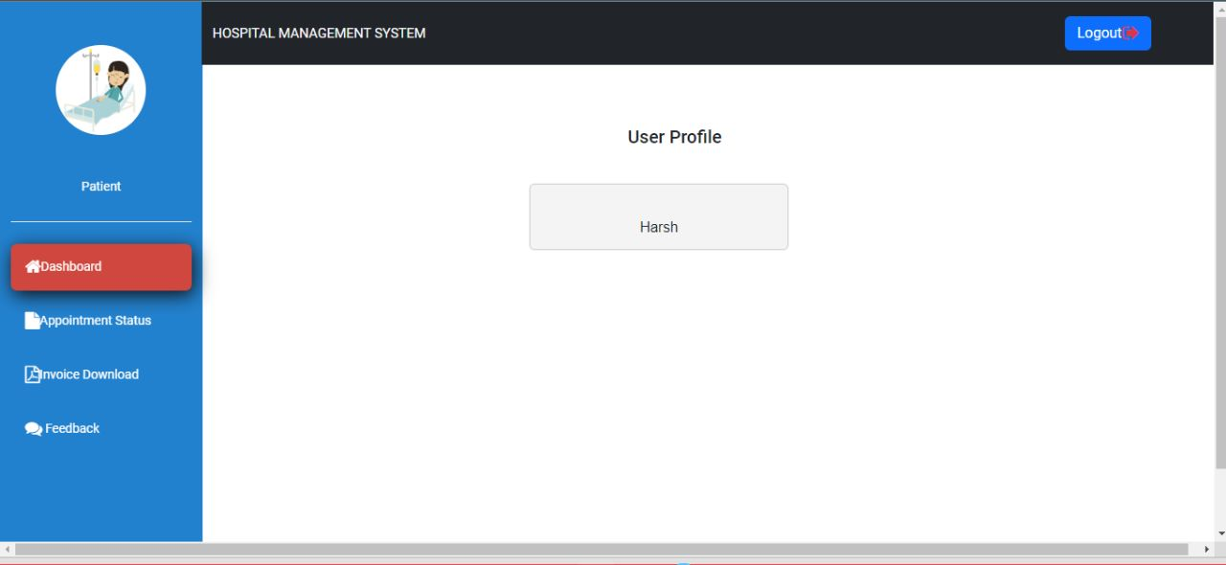
Patient Dashboard Page

Slide 38
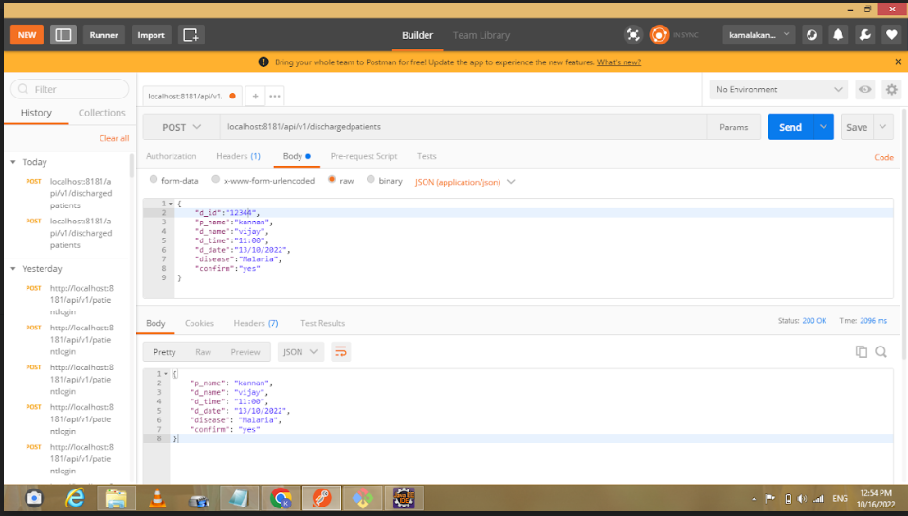
Testing

Slide 39
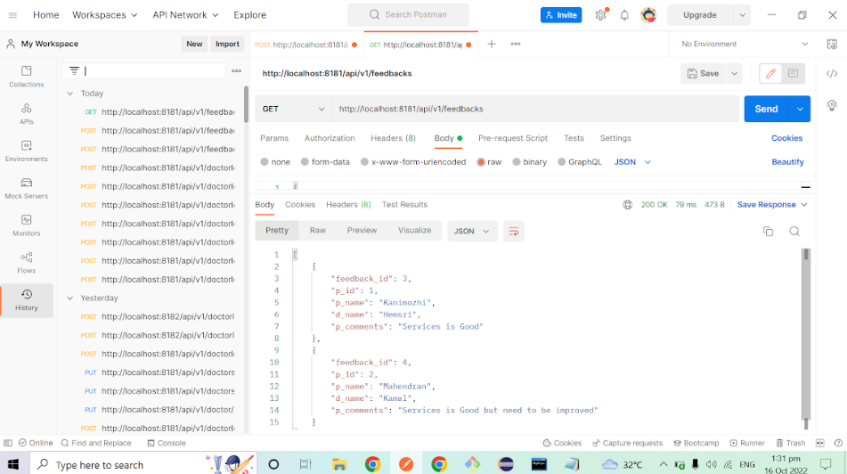
Testing
For more images,refer https://drive.google.com/drive/folders/1iATA3fKDLCTSav9srTciuiD3RQIO_MdD

Slide 40
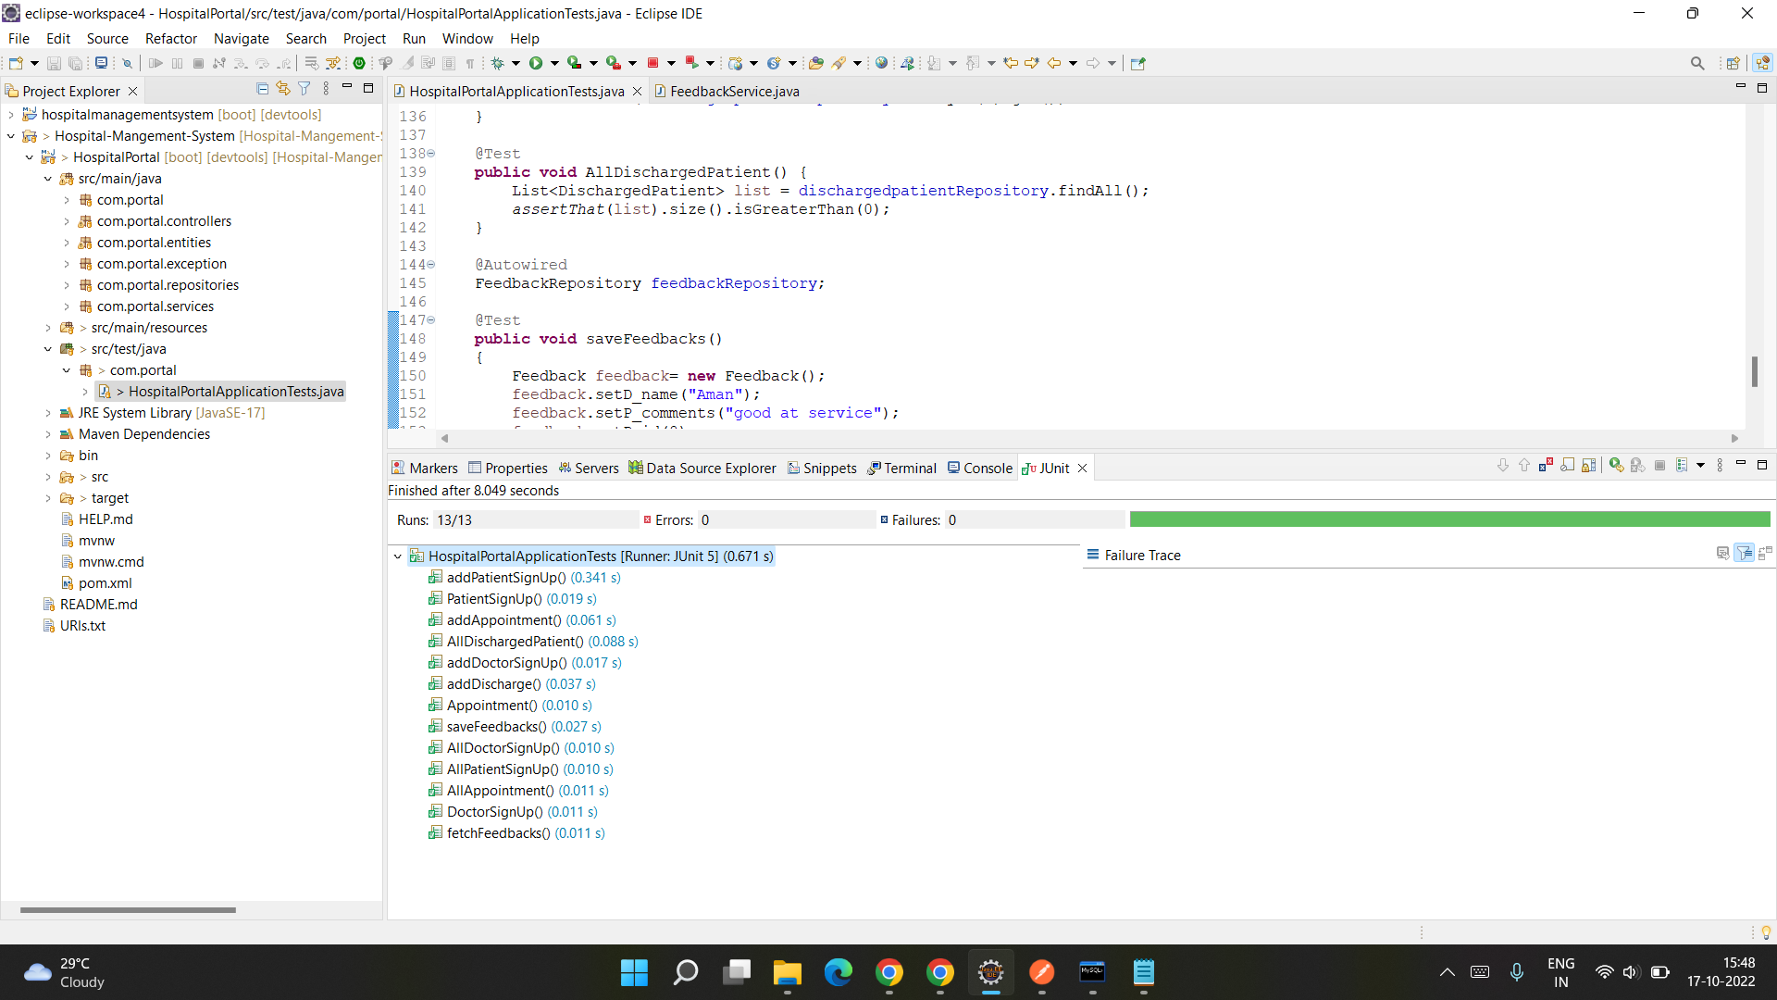
Testing

Slide 41


Advantage & Disadvantages
Advantage
Disadvantage
User friendly service
We can maintain the digital medical records
less time consumption
Patient self-service
Avoid errors and track every single details
It will affect the Employment of staffs working in administration

Slide 42

Future scope & Improvements
We will add security using Spring Security and Jwt Authentication on our Login and Sing up
Features such as availability of ambulance (24*7) , emergency room and blood groups in the hospital can be updated in our website for user knowledge
In future, we can improve the UI design and add more features

Slide 43

Conclusion
Hospital management systems allows us the ability to optimize and digitize all the processes within the institution
It will help to improve customer service, reduce process costs, streamline the search of medical records, bills, patients, doctors, etc
Hospital Management System will contributed enormously to better health and influenced the lives and well-being of billions of humans

Slide 44
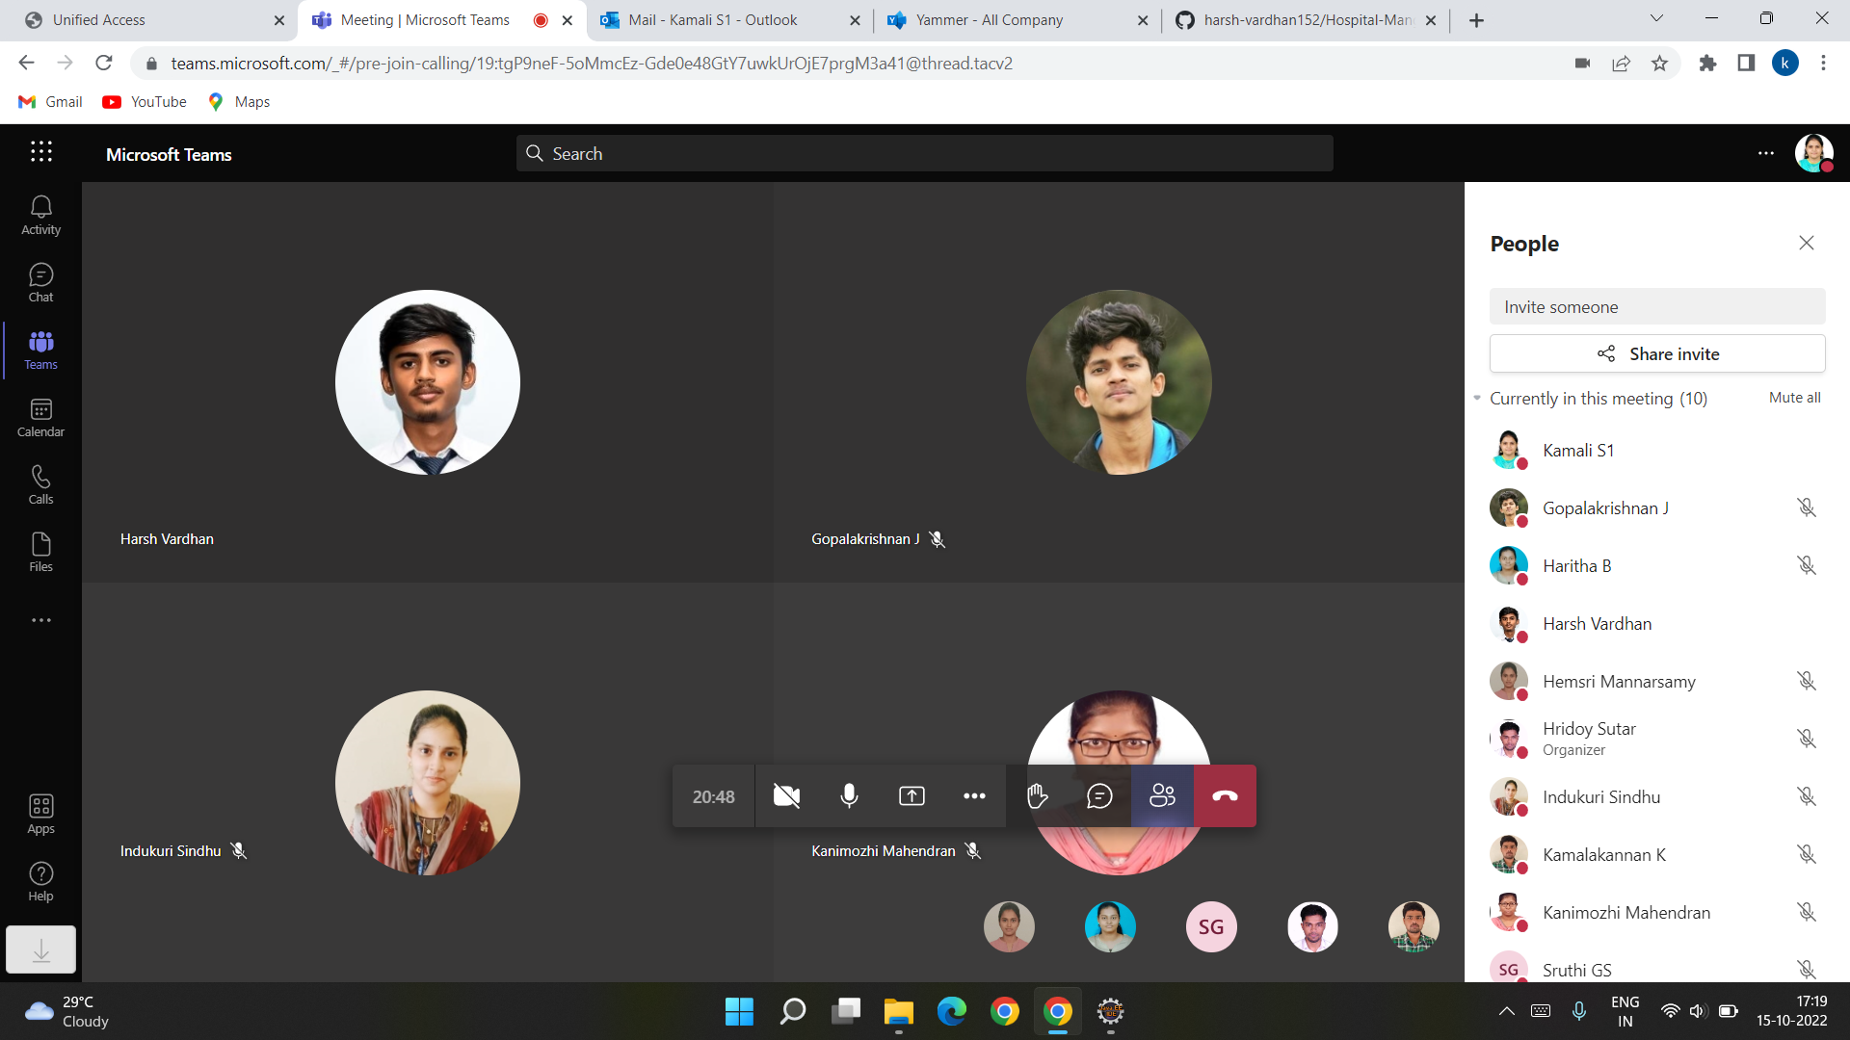
Meeting

Slide 45

Bibliography
YouTube
www.google.com
www.angular.io
www.w3school.com
www.stackoverflow.com

Slide 46


